Slide 1
Project Scheduling

Slide 2
Objective
To enable a project manager
To define work tasks
Establish their dependencies
Assign human resources to tasks
Develop variety of graphs, charts and tables

Slide 3
Mechanics
Project scheduling require the specification of work breakdown structure of tasks
Once the work breakdown is defined –
Start and End dates
Human resources
Hard deadlines
Other data
Generate variety of time-line charts and other tables

Slide 4
Representative Tools
AMS Realtime =
Provides scheduling capabilities for projects of all sizes and types
Microsoft Project =
Used for PC-based project scheduling
4C =
Supports all aspects of project planning including scheduling

Slide 5
Scheduling
Two methods –
Program Evaluation and Review Technique (PERT)
Critical Path Method (CPM)
PERT and CPM provide quantitative tools that allow you –
To determine the critical path—the chain of tasks that determines the duration of the project
To establish “most likely” time estimates for individual tasks by applying statistical models, and
To calculate “boundary times” that define a time “window” for a particular task.

Slide 6
Work Breakdown Structure –
Dividing a large complex project into simpler, manageable and independent tasks
Each node is recursively decomposed into smaller sub-activities, until at the leaf level, the activities becomes undividable and independent
Steps:
Step-1: Identify the major activities of the project.
Step-2: Identify the sub-activities of the major activities.
Step-3: Repeat till undividable, simple and independent activities are created.

Slide 7
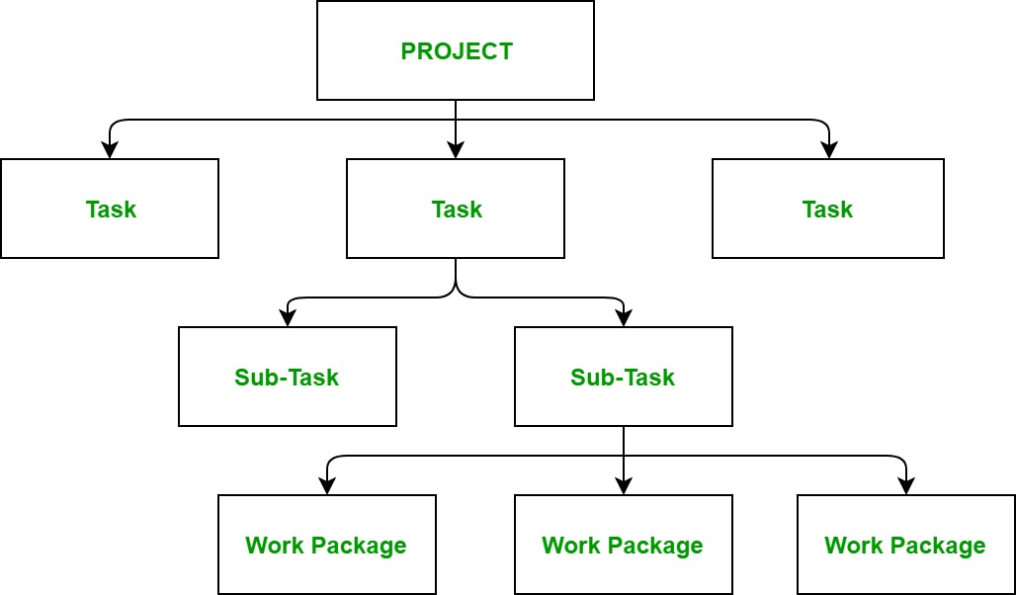
The efficiency and success of the whole project majorly depends on the quality of the Work Breakdown Structure of the project

Slide 8
The efficiency and success of the whole project majorly depends on the quality of the Work Breakdown Structure of the project
Uses –
Allows to do a precise cost estimation of each activity.
Allows to estimate the time that each activity will take more precisely.
Allows easy management of the project.
Helps in proper organization of the project by the top management.

Slide 9
Reasons for creating WBS in a Project –
Accurate and readable project organization
Accurate assignment of responsibilities to the project team
Indicates the project milestones and control points
Helps to estimate the cost, time and risk

Slide 10
Time-Line Chart
Used to illustrate a set of events chronologically
Excellent tool for conceptualizing event sequences
Types =
Gantt Chart
Vertical bar chart timeline
Chronological timeline
Static and Interactive timeline

Slide 11
Gantt Chart =
Grid-based diagram that project across calendar days
Used for large scale development projects with multiple stages and firm deadlines
Uses bars of varying sizes spread across a timeline to represent a task’s start date, duration, and finish date
Work Breakdown Structure is input as task outline
Effort, duration, start date are input for each task

Slide 12
Time-line chart shows software project schedule that emphasizes concept scoping task
All project tasks are listed in the left-hand column and the horizontal bars indicate the duration of each task
When multiple bars occur at the same time on the calendar, task concurrency is implied
The diamonds indicate milestones
Once the information necessary for the generation of a time-line chart has been input, the majority of software project scheduling tools produce project tables—a tabular listing of all project tasks, their planned and actual start and end dates, and a variety of related information

Slide 13
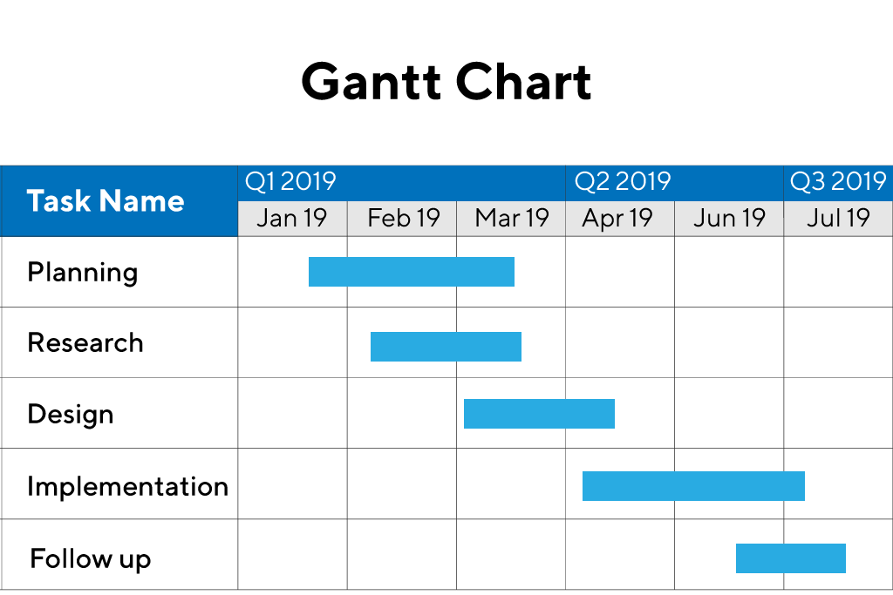

Slide 14
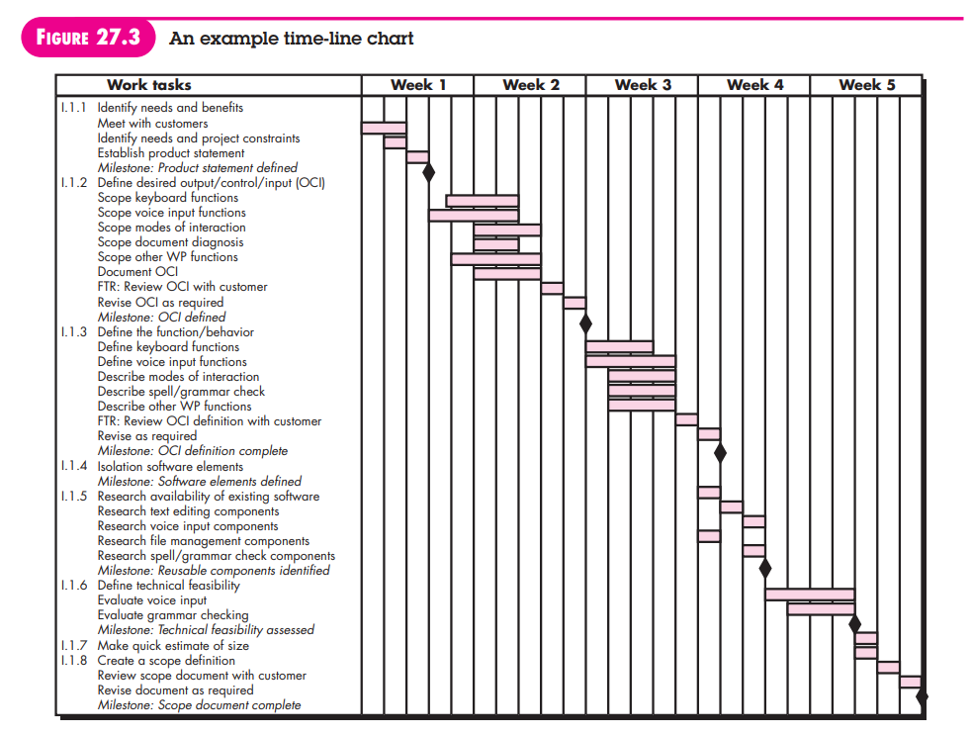

Slide 15
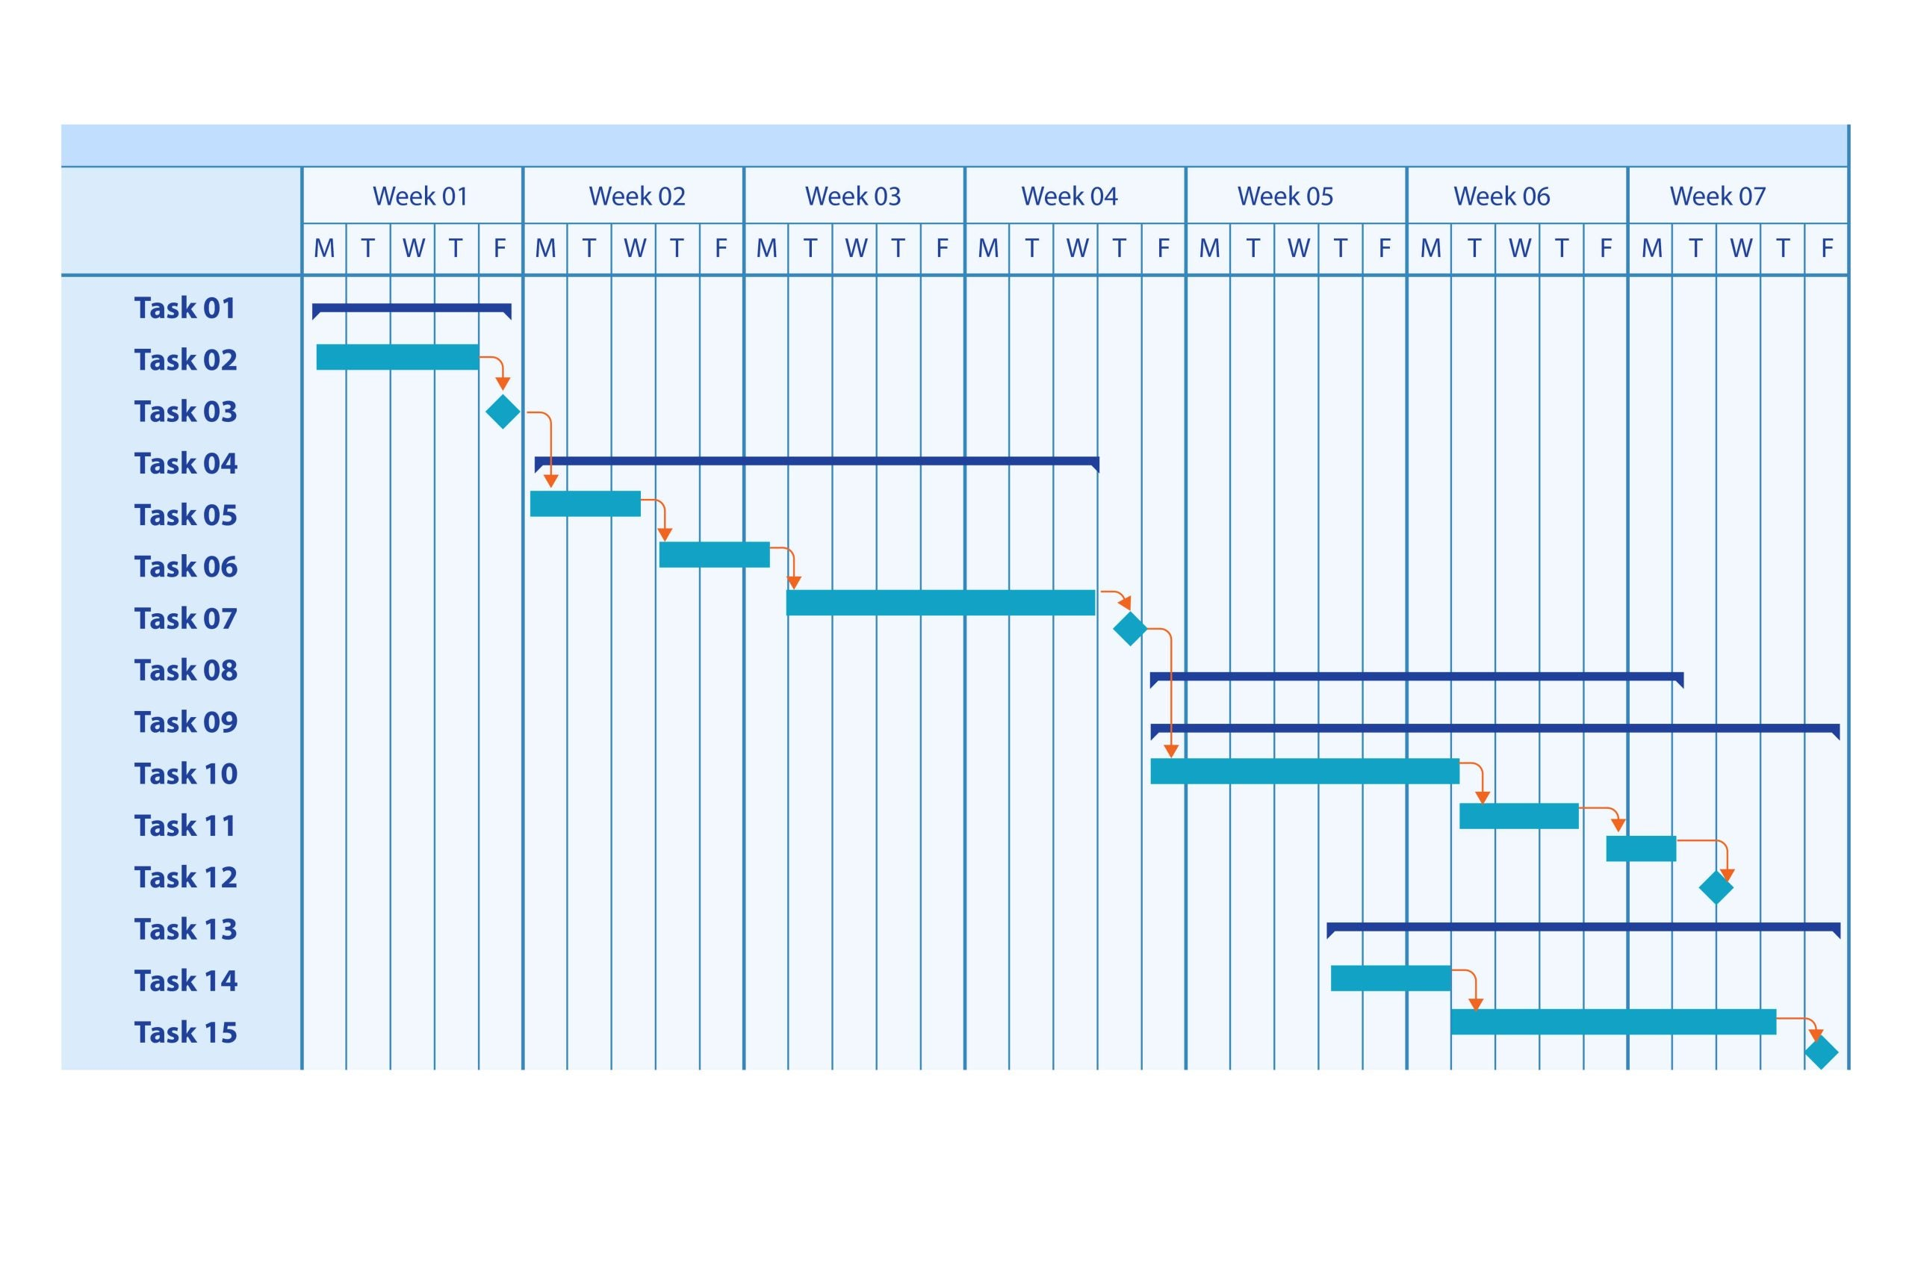

Slide 16
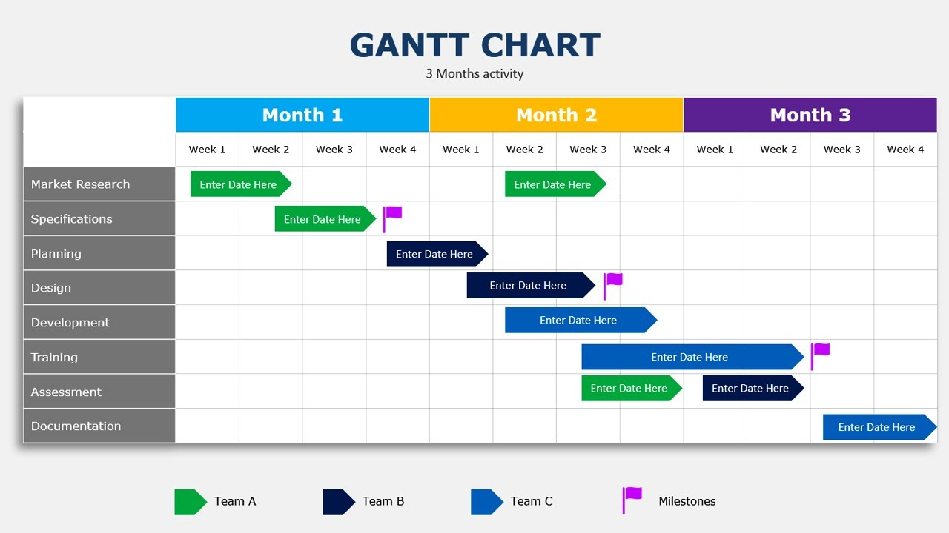

Slide 17
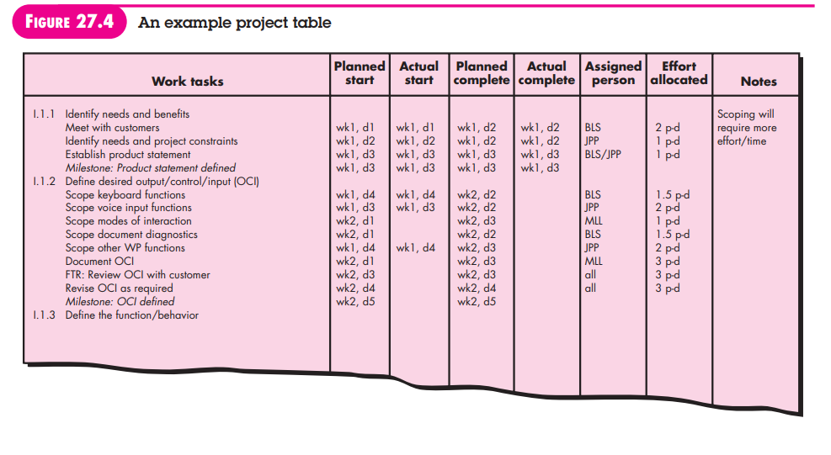

Slide 18
Tracking Schedule
Different Ways –
Conducting periodic project status meetings in which each team member reports progress and problems
Evaluating the results of all reviews conducted throughout the software engineering process
Determining whether formal project milestones have been accomplished by the scheduled date
Meeting informally with practitioners to obtain their subjective assessment of progress to date and problems on the horizon

Slide 19
Control is employed by a software project manager to administer project resources, cope with problems, and direct project staff
If things are going well then control is light
But when problems occur, you must exercise control to reconcile them as quickly as possible
When faced with severe deadline pressure, project managers use a time-boxing technique. The time-boxing strategy recognizes that the complete product may not be deliverable by the predefined deadline. Therefore, an incremental software paradigm is chosen, and a schedule is derived for each incremental delivery

Slide 20
Scheduling for WebApp Projects –
Distributes estimated effort across the planned time line (duration) for building each WebApp increment
During the first iteration, a macroscopic schedule is developed that identifies all WebApp increments and projects the dates on which each will be deployed
As the development of an increment gets under way, the entry for the increment on the macroscopic schedule is refined into a detailed schedule

Slide 21
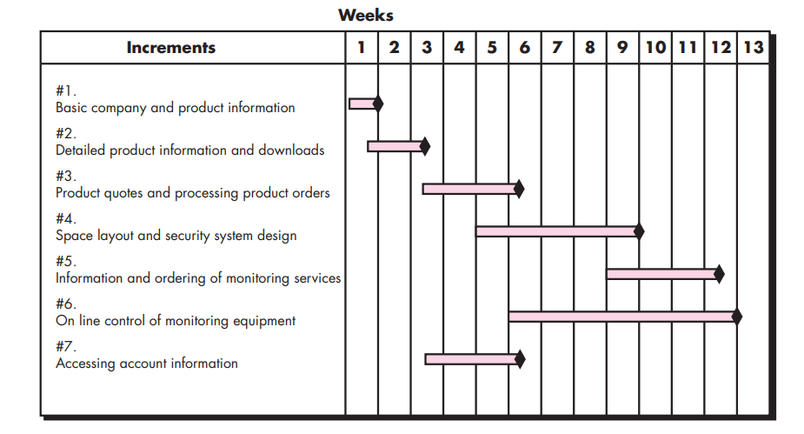
Example – Timeline chart for macroscopic project schedule SafeHomeAssured.com –

Slide 22
The team consults and negotiates with stakeholders and develops a preliminary deployment schedule for all seven increments
Deployment dates (represented by diamonds on the time-line chart) are preliminary and may change as more detailed scheduling of the increments occurs
Once the macroscopic schedule has been developed, the team is ready to schedule work tasks for a specific increment

Slide 23
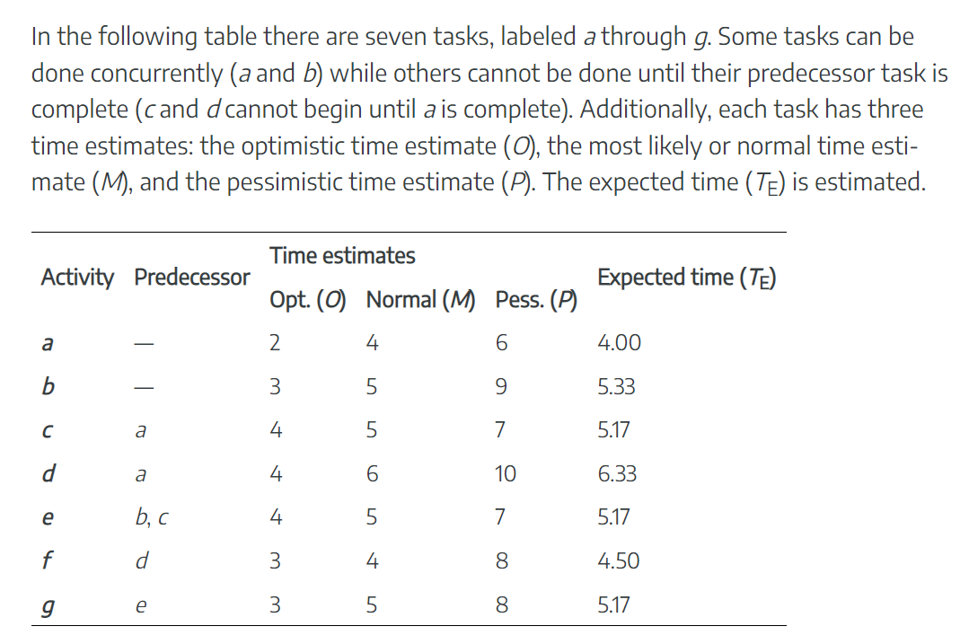
Example-1:

Slide 24
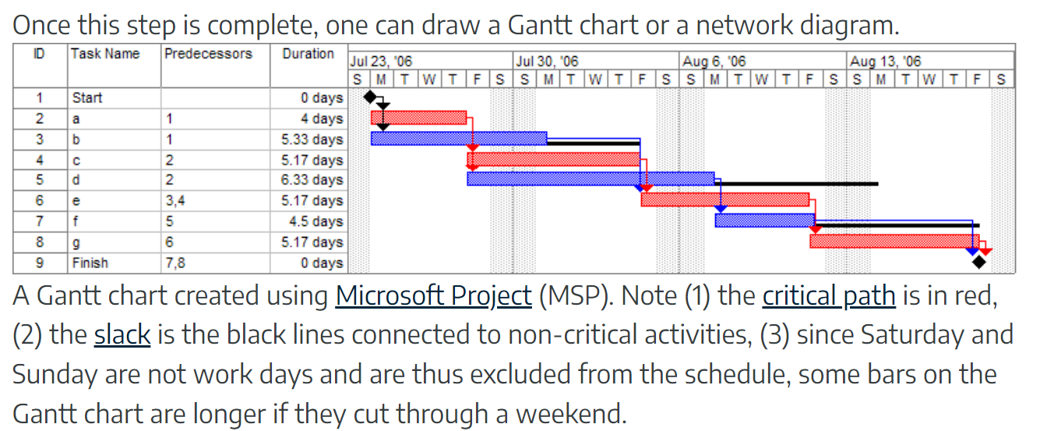
Solution:

Slide 25
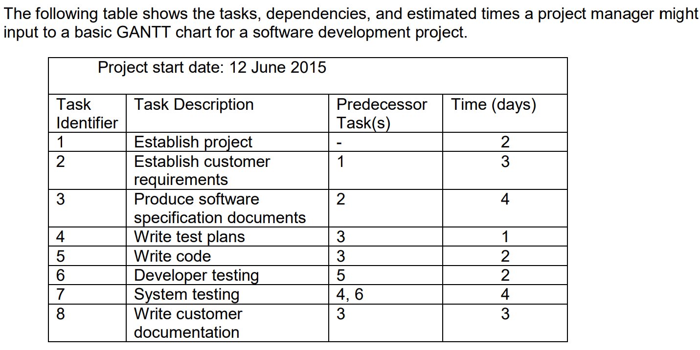
Example-2:

Slide 26
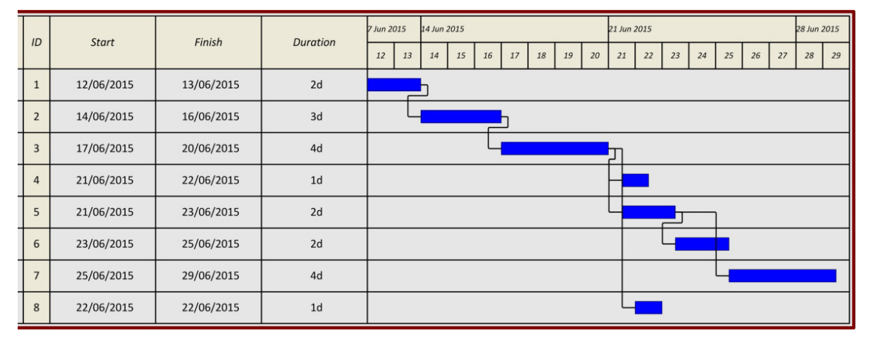
Solution:

